Slide 1


GROUND WATER QUALITY PREDICTION IN GUJARAT PROVINCE
Under Dr. Rajeev Kumar Gupta mentorship.
PROJECT
ABHIJEETSINGH MEENA (20BCP241)
SMIT RAVAL (20BCP259)

Slide 2

CONTENT
01
ABSTRACT
02
INTRODUCTION
03
LITRATURE SURVEY
04
PROBLEM DEFINITION
05
PROPOSED METHODOLOGY
06
CURRENT STATUS
07
RESULTS
08
GANTT CHART
09
CONCLUSION
10
REFRENCES

Slide 3
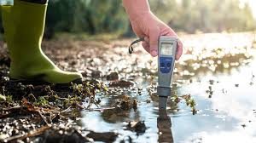

ABSTRACT
This study investigates groundwater quality prediction using Entropy based Water Quality Index (EBWQI) and Weighted Arithmetic Water Quality Index (WAWQI) formulas. It deals with various regression models and classification models to predict the ground water quality indices.
After downloading the PDF file from the government website, we extracted the data from it.
The analysis of the results shows the best performance in the CatBoost Model with an accuracy of approximately 96 % followed by LightGBM and XGBoost model with the accuracy of 95% accuracy and then followed by RandomForest Classifier with the value of 93% accuracy.

Slide 4

INTRODUCTION
Water is an essential resource crucial for sustaining life on Earth, requiring a certain quality to support various species, including humans[1].
While covering a significant portion of the planet's surface, only a small fraction is freshwater, with groundwater being vital for activities like irrigation and drinking but susceptible to contamination from human activities.
Researchers assess groundwater suitability using parameters like pH and Electrical Conductivity (EC)[5], but this can be challenging and costly[6].
As a cost-effective alternative, water quality indices like WAWQI and EBWQI[7] have emerged. Machine learning techniques have become prominent in predicting groundwater quality for drinking purposes[8], outperforming traditional statistical methods[9].

Slide 5

LITERATURE SURVEY
Paper Name | Paper’s Insights
Prediction of groundwater quality indices using machine learning algorithms | The methods in our project were taken from a paper that compares three machine learning algorithms (Deep Neural Network, Gradient Boosting Machine, Extreme Gradient Boosting) for predicting groundwater quality indices (Entropy Water Quality Index and Water Quality Index) in Haryana, India. Results indicate that the Deep Neural Network outperforms the other models, showing lower error values and higher accuracy for both indices. Electrical Conductivity (EC) is identified as the most significant input parameter, while pH is the least significant. The study suggests using DNN models to predict groundwater quality for potability assessment, emphasizing the importance of machine learning in this context [2].
Groundwater Quality Evaluation for Potable Use and Associated Human Health Risk in Gaobeidian City, North China Plain | The second paper assesses groundwater quality in Gaobeidian City and its potential health risks for children and adults. The entropy weight method determines parameter weights for groundwater quality evaluation. Parameters including NO2-, Fe, As, Cr6, and NO2-N are key influencers. The study classifies groundwater quality as Excellent Water (class 1) based on entropy weighted water quality index. Groundwater quality deterioration is observed in the southwest. Natural factors are presumed to impact groundwater chemistry more than human activities. Certain water samples pose noncarcinogenic health risks to both adults and children, primarily due to F-, NO2-, NO3-, and Cr6 concentrations [4].
Groundwater Quality: The Application of Artificial Intelligence | Another paper we read the study develops a hybrid model using single exponential smoothing (SES) with bidirectional long short-term memory (BiLSTM) and adaptive neuro-fuzzy inference system (ANFIS) to predict water quality (WQ) in Al-Baha, Saudi Arabia. Data were split into training and testing phases, and efficiency statistics assessed the SES-BiLSTM and SES-ANFIS models' prediction abilities. Both models performed well in predicting water quality index (WQI), but SES-BiLSTM had higher accuracy (R 99.95, RMSE 0.00910) during testing compared to SES-ANFIS (R 99.95, RMSE 2.2941 x 100-07). Results suggest both models can predict WQI accurately, potentially enhancing water quality [11].

Slide 6
PROBLEM DEFINITION
The project aims to address the challenge of predicting groundwater quality in the Gujarat province. With increasing industrialization, agricultural activities, and urbanization, groundwater contamination has become a significant concern in the region.
The lack of accurate and timely assessment tools hampers effective water resource management efforts. Therefore, the project seeks to develop a robust predictive model that can reliably forecast groundwater quality, aiding in informed decision-making for sustainable water management practices in Gujarat.

Slide 7

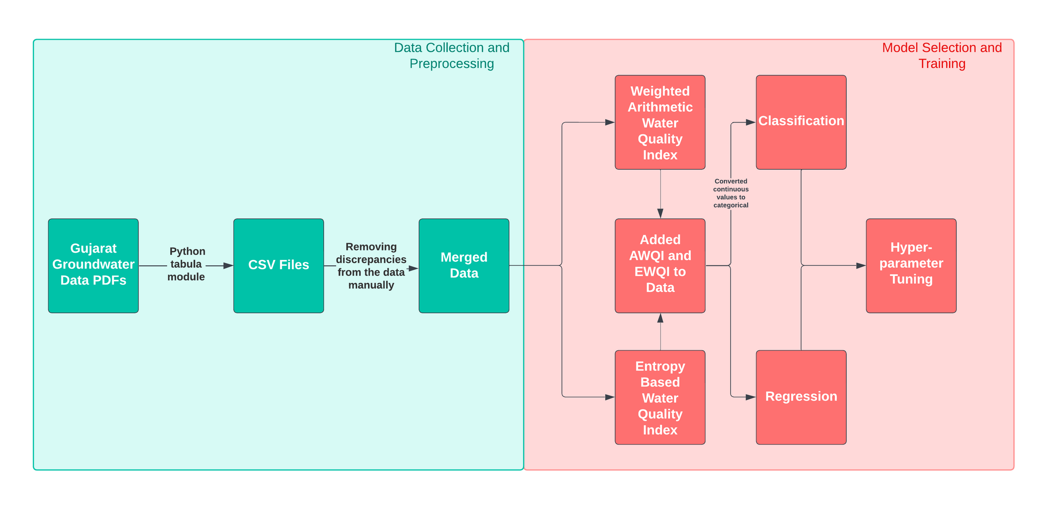
PROPOSED METHODOLOGY

Slide 8
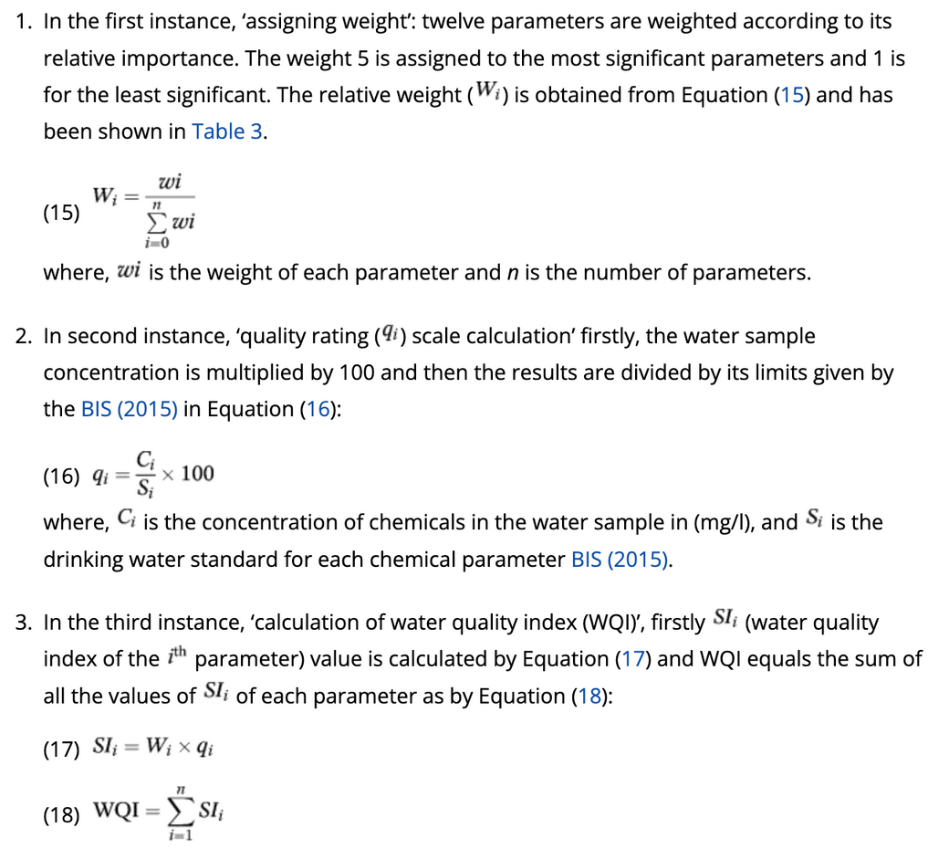
PROPOSED METHODOLOGY
Weighted Arithmetic Water Quality Index
Note : From “Prediction of groundwater quality indices using machine learning algorithms” by IWA Publishing, 2021,
(https://iwaponline.com/wpt/article/17/1/336/85564/Prediction-of-groundwater-quality-indices-using)

Slide 9
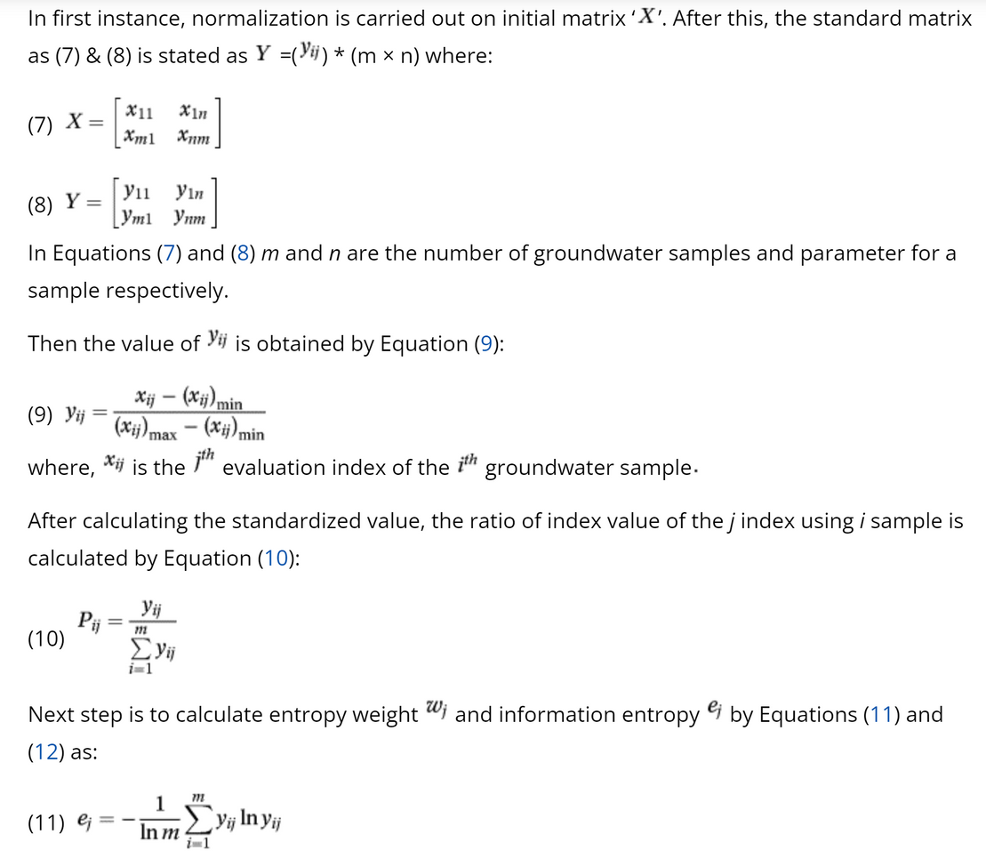
PROPOSED METHODOLOGY
Entropy Based Water Quality Index
Note : From “Prediction of groundwater quality indices using machine learning algorithms” by IWA Publishing, 2021,
(https://iwaponline.com/wpt/article/17/1/336/85564/Prediction-of-groundwater-quality-indices-using)

Slide 10
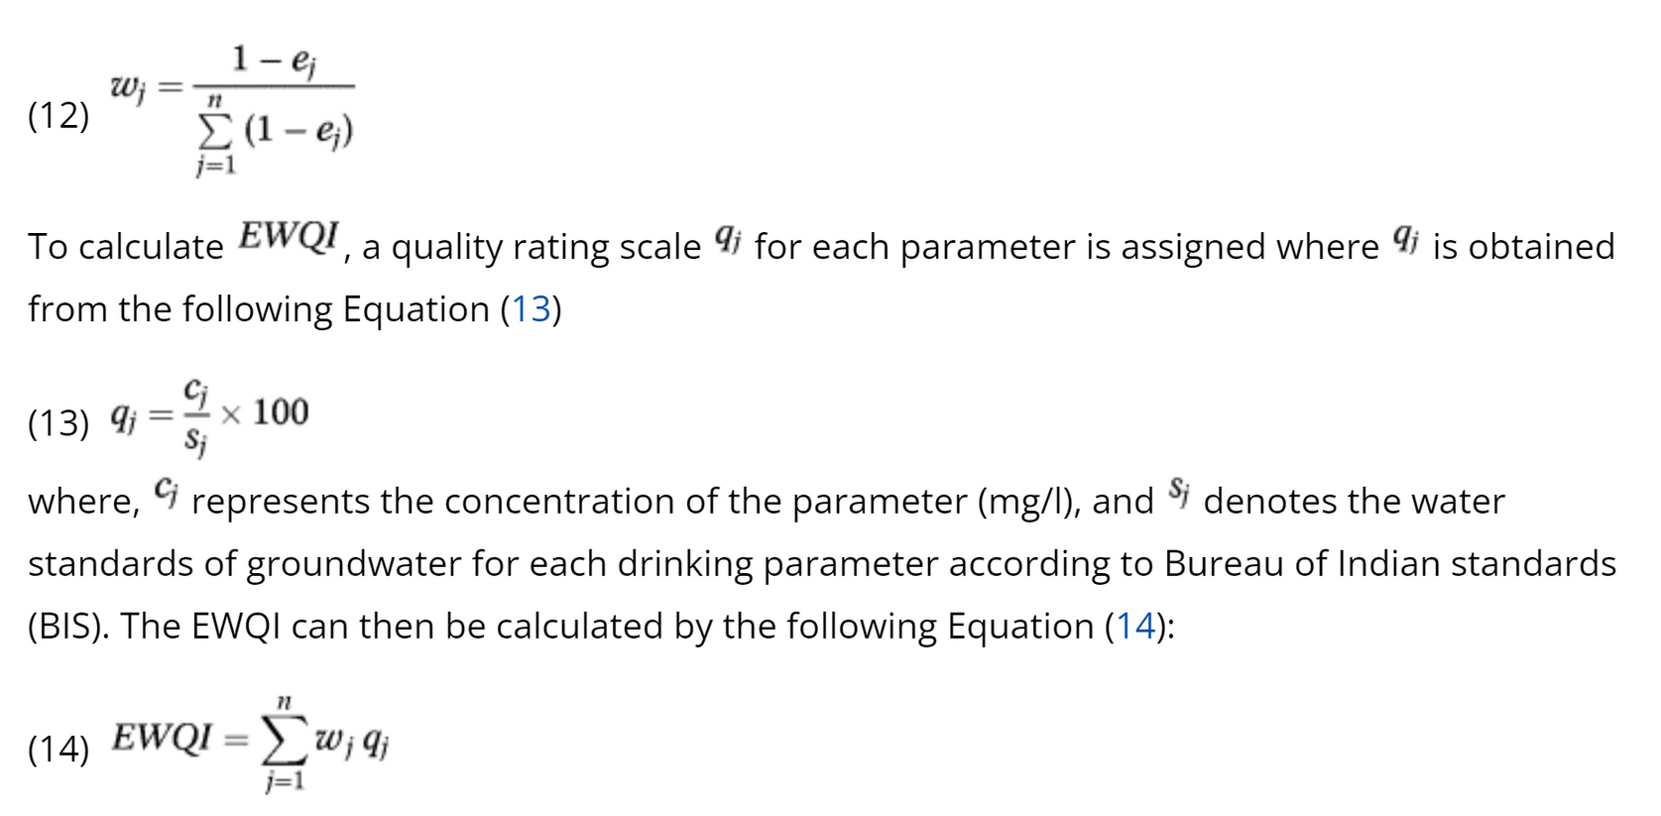
PROPOSED METHODOLOGY
Entropy Based Water Quality Index
Note : From “Prediction of groundwater quality indices using machine learning algorithms” by IWA Publishing, 2021,
(https://iwaponline.com/wpt/article/17/1/336/85564/Prediction-of-groundwater-quality-indices-using)

Slide 11
CURRENT STATUS
The initial phase of our study involved a comprehensive analysis of the topic, which included a thorough review of relevant research papers to establish a foundational understanding. Subsequently, data acquisition was undertaken by retrieving pertinent information from government websites in PDF format. We then meticulously extracted and compiled this data into a well-structured CSV file encompassing multiple years for comprehensive analysis. Following this, rigorous data cleaning procedures were implemented to ensure the integrity and quality of the dataset.
Furthermore, in our pursuit to explore alternative methodologies beyond the WAWQI, we delved into researching various other methods. Upon establishing a robust dataset, we applied both EBWQI and WAWQI formulas to evaluate groundwater quality.
To assess predictive performance, an array of regression and classification models was employed, enabling a comparative analysis between methodologies and determining the superior approach among EBWQI and WAWQI. Hyperparameter tuning techniques were then utilized to optimize model performance.
Finally, the ensemble method of Voting Classifier was applied to further enhance predictive accuracy by aggregating results from multiple classification models.

Slide 12
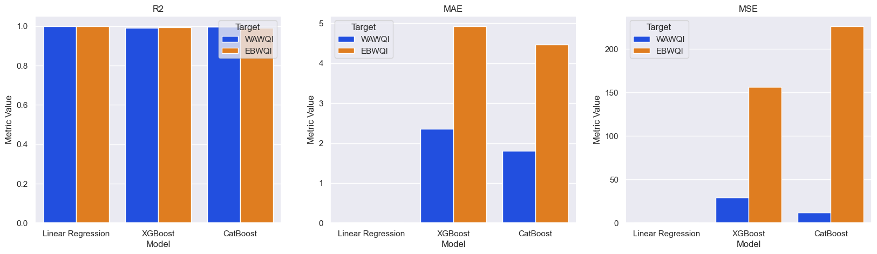
RESULTS
REGRESSION

Slide 13
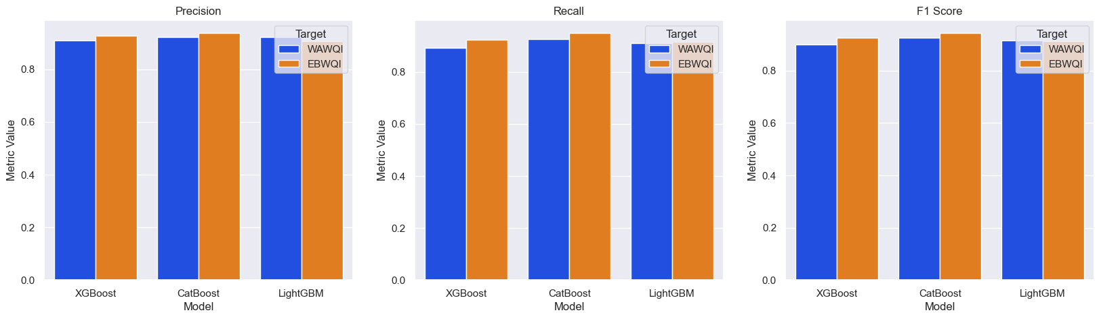
RESULTS
CLASSIFICATION

Slide 14
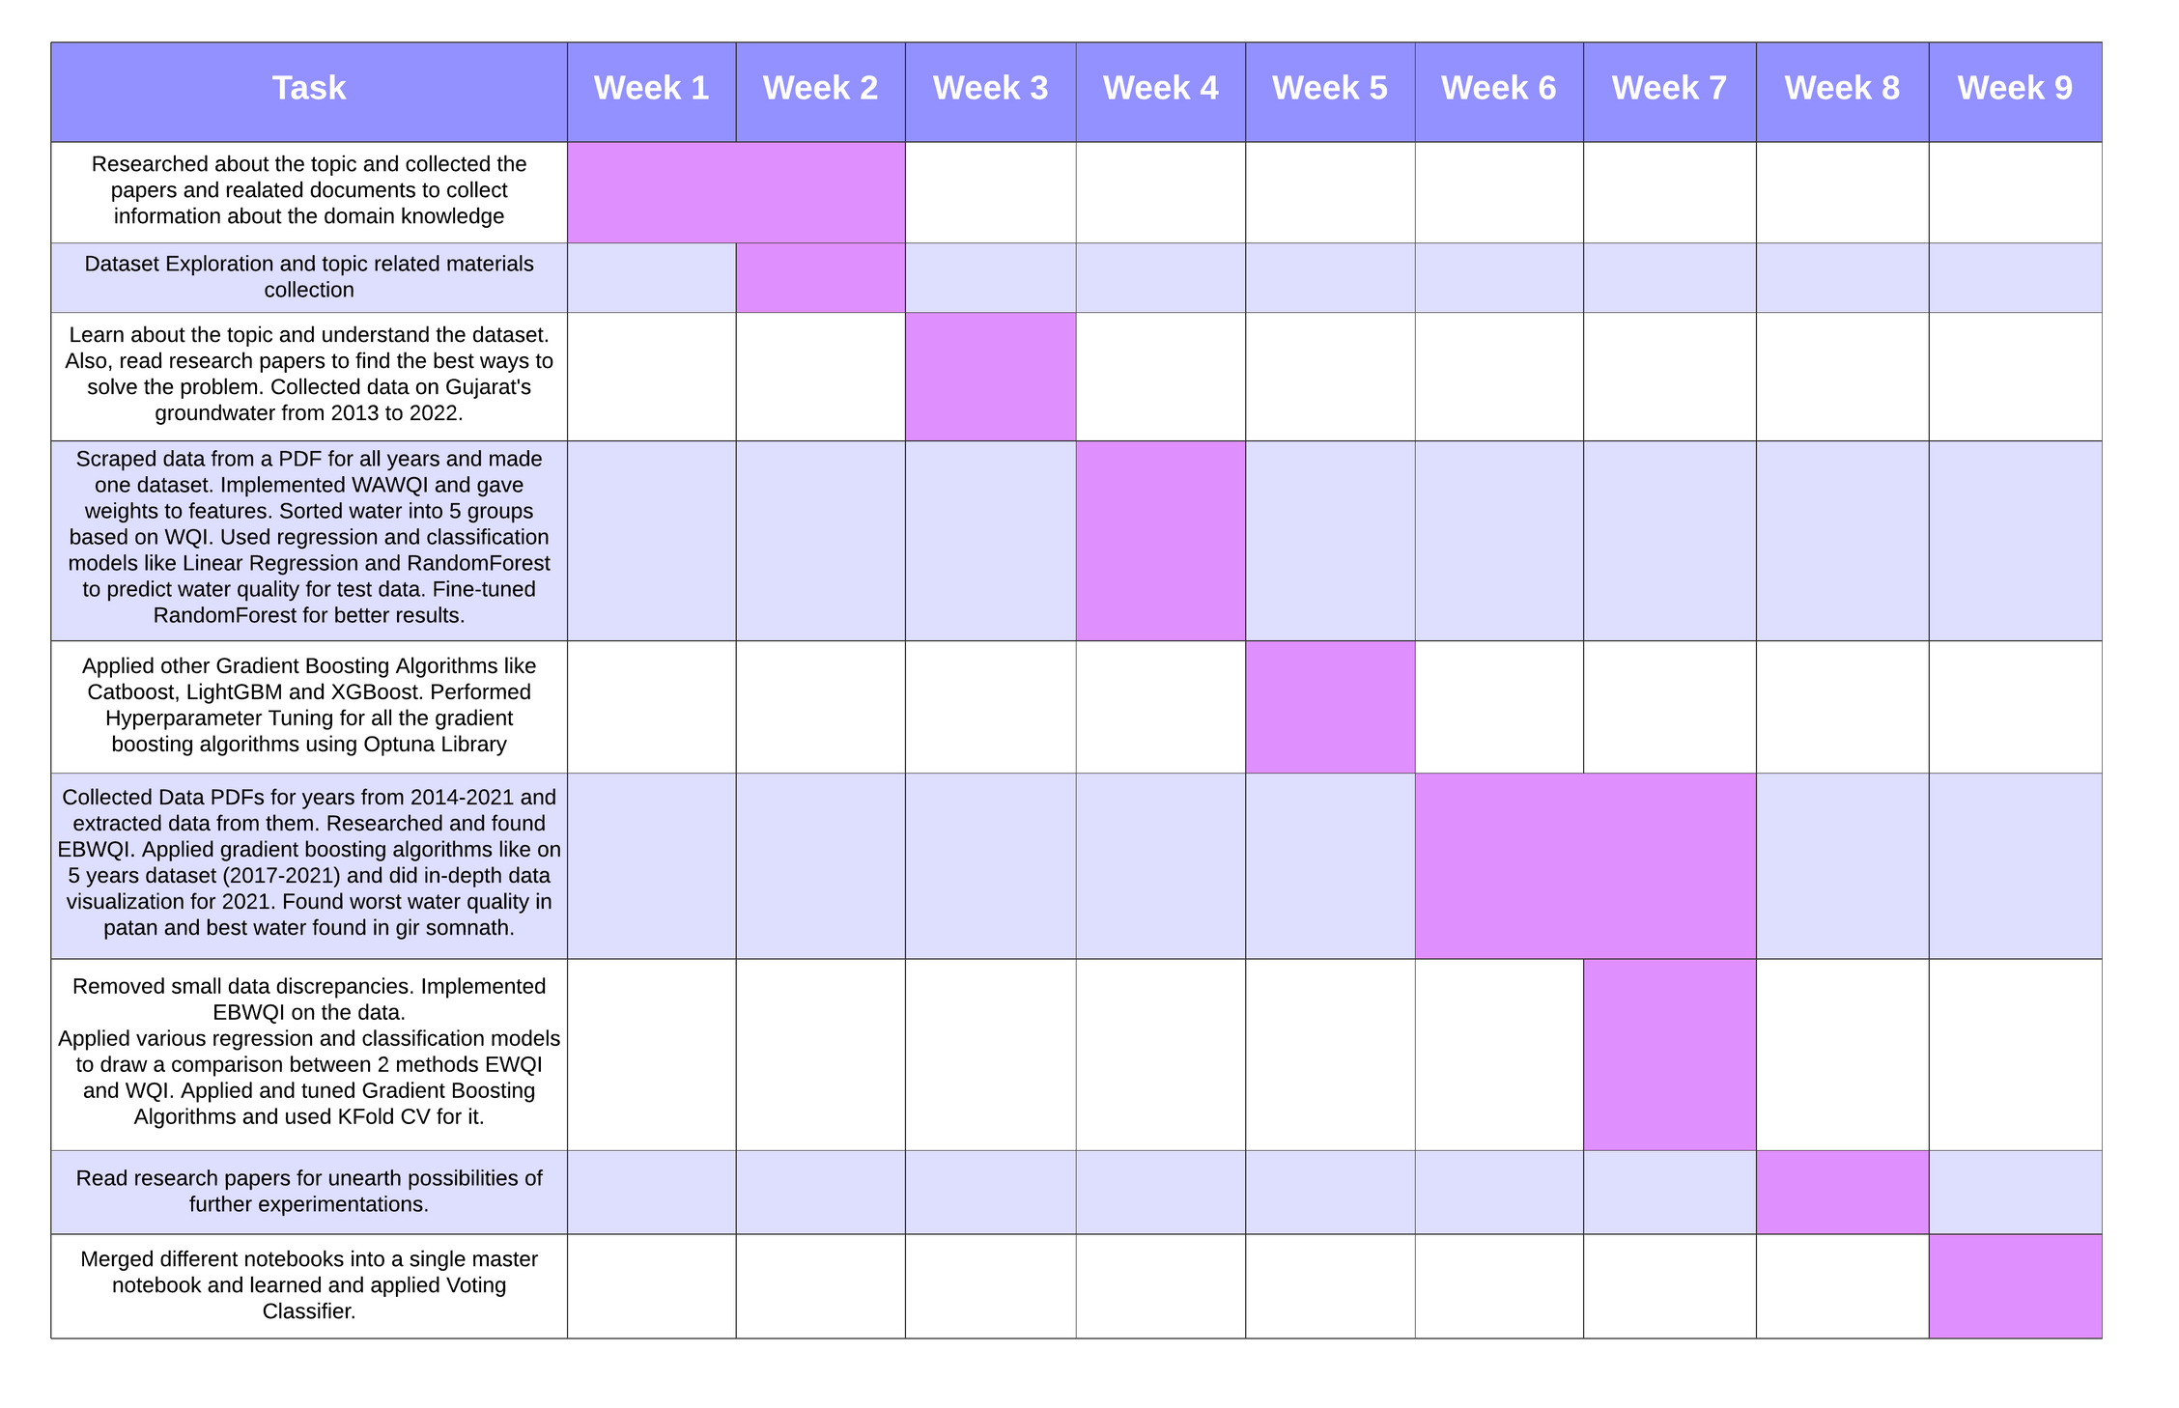
GANTT CHART

Slide 15
CONCLUSION
In conclusion, our study focused on predicting groundwater quality by applying the Weighted Arithmetic Water Quality Index (WAWQI) and Entropy based Water Quality Index (EBWQI) formulas to classify water into five distinct categories based on various parameters. By calculating WAWQI and EBWQI values, we were able to assess the overall quality of groundwater samples.
Furthermore, we utilized regression and classification techniques to analyze the relationship between input parameters and WAWQI/EBWQI values, as well as to predict the category of groundwater quality and to compare different model's performance. Among the models evaluated, the CatBoost model demonstrated the highest results in classification tasks.
Overall, our findings suggest that the combination of WAWQI and EBWQI formulas, coupled with advanced machine learning techniques such as CatBoost, can effectively predict groundwater quality and aid in making informed decisions regarding water resource management and environmental conservation efforts.
The analysis of the results shows the best performance in the CatBoost Model with an accuracy of approximately 96 % followed by LightGBM and XGBoost model with the accuracy of 95% accuracy and then followed by RandomForest Classifier with the value of 93% accuracy.

Slide 16
REFRENCES
[1]Mohamed, I., Othman, F., Ibrahim, A. I. N., Alaa-Eldin, M. E., & Yunus, R. M. (2014, November 30). Assessment of water quality parameters using multivariate analysis for Klang River basin, Malaysia. Environmental Monitoring and Assessment. https://doi.org/10.1007/s10661-014-4182-y
[2]Raheja, H., Goel, A., & Pal, M. (2021, December 1). Prediction of groundwater quality indices using machine learning algorithms. Water Practice & Technology. https://doi.org/10.2166/wpt.2021.120
[3]Chaudhari, A. N., Mehta, D., & Sharma, N. (2021, March 24). An assessment of groundwater quality in South-West zone of Surat city. Water Science & Technology: Water Supply. https://doi.org/10.2166/ws.2021.083
[4]Fu, X., Dong, Z., Gan, S., Wang, Z., & Wei, A. (2021, November 22). Groundwater Quality Evaluation for Potable Use and Associated Human Health Risk in Gaobeidian City, North China Plain. Journal of Chemistry. https://doi.org/10.1155/2021/3008567
[5]Vasanthavigar, M., Srinivasamoorthy, K., Vijayaragavan, K., Ganthi, R. R., Chidambaram, S., Anandhan, P., Manivannan, R., & Vasudevan, S. (2010, January 21). Application of water quality index for groundwater quality assessment: Thirumanimuttar sub-basin, Tamilnadu, India. Environmental Monitoring and Assessment. https://doi.org/10.1007/s10661-009-1302-1
[6]Kumar, V., Amarender, B., Dhakate, R., Sankaran, S., & Kumar, K. (2014, June 15). Assessment of groundwater quality for drinking and irrigation use in shallow hard rock aquifer of Pudunagaram, Palakkad District Kerala. Applied Water Science. https://doi.org/10.1007/s13201-014-0214-6
[7]Kumar, P. J. S., & Augustine, C. M. (2021, February 23). Entropy-weighted water quality index (EWQI) modeling of groundwater quality and spatial mapping in Uppar Odai Sub-Basin, South India. Modeling Earth Systems and Environment. https://doi.org/10.1007/s40808-021-01132-5
[8]Wang, D., Wu, J., Wang, Y., & Ji, Y. (2019, June 10). Finding High-Quality Groundwater Resources to Reduce the Hydatidosis Incidence in the Shiqu County of Sichuan Province, China: Analysis, Assessment, and Management. Exposure and Health. https://doi.org/10.1007/s12403-019-00314-y
[9]Adimalla, N., Qian, H., & Li, P. (2020, December 1). Entropy water quality index and probabilistic health risk assessment from geochemistry of groundwaters in hard rock terrain of Nanganur County, South India. Geochemistry. https://doi.org/10.1016/j.chemer.2019.125544
[10]Perumal, B., Rajarethinam, N., Velusamy, A. I. S., & Sundramurthy, V. P. (2023, November 7). Water Quality Prediction Based on Hybrid Deep Learning Algorithm. Advances in Civil Engineering. https://doi.org/10.1155/2023/6644681
[11]Al-Adhaileh, M. H., Aldhyani, T. H. H., Alsaade, F. W., Al-Yaari, M., & Albaggar, A. K. A. (2022, August 24). Groundwater Quality: The Application of Artificial Intelligence. Journal of Environmental and Public Health. https://doi.org/10.1155/2022/8425798

Slide 17

THANK YOU

